Slide 1
Module 21 – Multithreading

Slide 2
Resources
Video | Parallel and Concurrent Programming with Java 1
https://www.linkedin.com/learning/parallel-and-concurrent-programming-with-java-1/learn-parallel-programming-basics
Free access with your MC Credential
2. Threads & Processes
Java Multi-Threading Series
https://medium.com/@brendoncheung/java-multi-threading-series-part-1-84bbd1227919
Check out Parts 2 & 3 as well
Notes:
https://techcommunity.microsoft.com/t5/windows-blog-archive/pushing-the-limits-of-windows-processes-and-threads/ba-p/723824

Slide 3
Additional Resources
Concurrency | Oracle | The Java Tutorials
https://docs.oracle.com/javase/tutorial/essential/concurrency/index.html
A gentle introduction to multithreading
https://www.internalpointers.com/post/gentle-introduction-multithreading
Information in these slides was taken from –
Liang, Introduction to Programming & Data Structures
The Java Tutorials from Oracle

Slide 4
Concurrency
Service 2+ customers at the same time
Surf the Web & listen to music (simultaneously)
Windows Task Manager (Microsoft Windows)
What’s running on your computer right now?
Google now processes over _____ search queries every second on average
www.internetlivestats.com/google-search-statistics/
Notes:
Concurrency vs. parallel processing

Slide 5
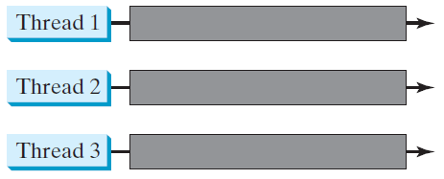
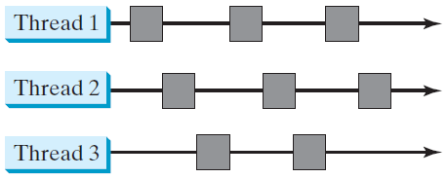
Threads Concept
Multiple threads on multiple CPUs
Multiple threads sharing a single CPU
Notes:
Processes vs. Threads
Concurrency vs. parallel

Slide 6
Processes & Threads
Computer system has many active processes & threads
Windows 10 Task Manager
Single execution core
One thread executing at any given moment
Processing time for a single core is shared (among processes & threads)
Multiple processors or multiple execution cores
Enhances a system's capacity for concurrent execution of processes
In Java, mostly concerned with threads
Most implementations of the Java virtual machine run as a single process
Notes:
Process vs. Thread

Slide 7
Processes
Self-contained execution environment
Has a complete, private set of basic run-time resources
Has its own memory space
Many (most) applications are a set of cooperating processes
most operating systems support Inter Process Communication (IPC) resources, such as pipes and sockets
IPC is used for communication between processes on the same system, and processes on different systems

Slide 8
Threads
Also known as lightweight processes
Threads exist within a process
every process has at least one
a new thread requires fewer resources than a process
Threads share the process's resources
memory and open files

Slide 9
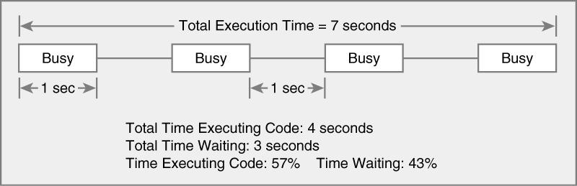
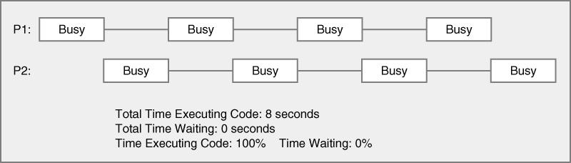
Threads in Single Execution Core
Single Threaded
program
Multi-threaded
The Java Virtual Machine executes each thread in the program for a short amount of time
Mulit-threaded
program
This gives the impression of concurrent (parallel) execution
Notes:
What are we looking at?
Why are there gaps?
Why should we consider multi-threading?

Slide 10
Multi-threading
Use threads to improve the performance or responsiveness of your application
May run GUI for your application in 1 thread
May run processor-heavy tasks in 1 thread
May run file manipulation tasks in 1 thread
May run animation in 1 thread

Slide 11
Threads
Every Java application has at least one
main thread
This thread has the ability to create additional threads
"system" threads
memory management and signal handling
garbage collection

Slide 12
Single Thread
When single-threaded program starts
Has sole control of process until it ends
May wait for user input or I/O operation
Why is this bad?
Nothing else occurs in JVM
Possible exception of some “system” threads

Slide 13
Thread Scheduler
Operating System feature
runs each thread for a short amount of time (time slice)
Scheduler then activates another thread
There will always be slight variations in running times
Especially when calling operating system services (e.g. input and output)
No guarantee about the order in which threads are executed

Slide 14
Concurrency & Multithreading
Things to consider
Implement & terminate threads
Race conditions and deadlocks
Avoid corruption of shared objects by using locks and conditions

Slide 15
Running a Thread
Create a class that implements the Runnable interface
public interface Runnable { void run(); }

Slide 16
Running a Thread
Place the code for your task into the run method of your class
public class MyRunnable implements Runnable { public void run() { // Task statements go here . . . } }

Slide 17
Running a Thread
Create an object of your subclass
Construct a Thread object from the runnable object.
Call the start method to start the thread
Runnable r = new MyRunnable();
Thread t = new Thread(r);
t.start();

Slide 18
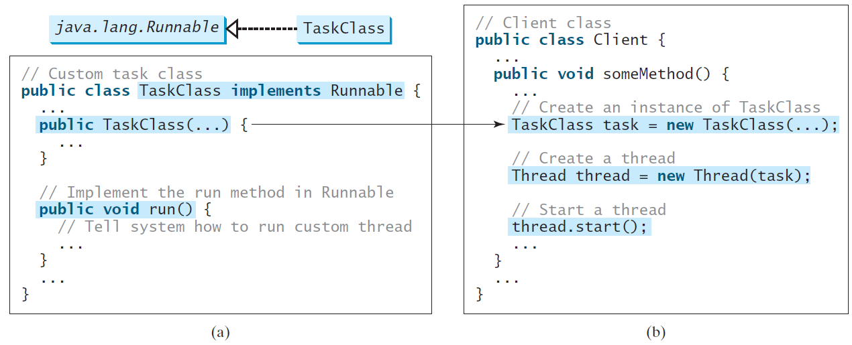
Creating Tasks and Threads

Slide 19
Movie Example
Have you played game & watched movie at the same time?
Create a program to simulate that
Run the provided Movie-example project
What happens if you don’t use threads?
Expand the code to include another thread (Thread 3)
What if you did not utilize thread to program this example?

Slide 20
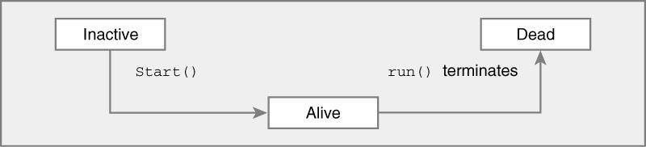
Life of a Thread

Slide 21
Terminating Threads
A thread terminates (ends) when its run method terminates
Do not terminate a thread using the deprecated stop method
Instead, notify a thread that it should terminate:
t.interrupt();
interrupt does not cause the thread to terminate – it is intended to gets its attention - it sets a boolean variable in the thread data structure. The usual response is for the thread to terminate itself

Slide 22
Terminating Threads
The sleep method throws an InterruptedException when a sleeping thread is interrupted
If a sleeping thread is interrupted
Catch the exception
Terminate the thread
Java does not force a thread to terminate when it is interrupted
It is entirely up to the thread what it does when it is interrupted
Interrupting is a general mechanism for getting the thread’s attention

Slide 23
Take Home | TaskThread Demo
Using the Runnable Interface, create and launch the following three threads:
The first thread prints the letter a 100 times
The second thread prints the letter b 100 times
The third thread prints the integers 1 through 100
TaskThreadDemo
Notes:
Complete this activity (use the “movie example” as a guide)
Solution is provided; see the in class examples (compressed file)

Slide 24
Activity | INT Example
Run the provided INT Example
t1.start() vs. t1.run()
http://www.java67.com/2015/12/difference-between-thread-start-and-run-method-java.html

Slide 25
Join
Join method allows one thread to wait for the completion of another. If t is a Thread object whose thread is currently executing
t.join();
causes the current thread to pause execution until t's thread terminates. Overloads of join allow the programmer to specify a waiting period
However, as with sleep, join is dependent on the OS for timing, so you should not assume that join will wait exactly as long as you specify
Like sleep, join responds to an interrupt by exiting with an InterruptedException

Slide 26
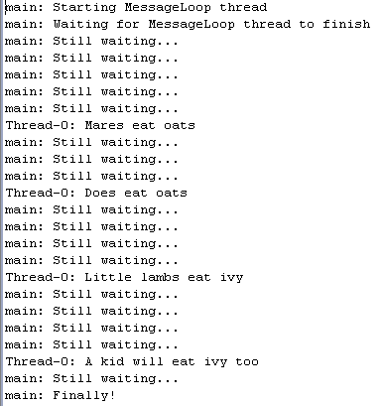
Activity | Join Example
Run provided example

Slide 27
Race Conditions
Occurs if the effect of multiple threads on shared data depends on the order in which they are scheduled
It is possible for a thread to reach the end of its time slice in the middle of a statement
It may evaluate the right-hand side of an equation but not be able to store the result until its next turn
Example
Create a BankAccount object
Create two sets of threads
Each thread in the first set repeatedly deposits $150
Each thread in the second set repeatedly withdraws $150

Slide 28
Activity | Race Condition Example
Normally, the program output looks somewhat like this:
Depositing 100.0, new balance is 100.0
Withdrawing 100.0, new balance is 0.0
Depositing 100.0, new balance is 100.0
Depositing 100.0, new balance is 200.0
Withdrawing 100.0, new balance is 100.0
...
Withdrawing 100.0, new balance is 0.0
But sometimes you may notice messed-up output, like this:
Depositing 100.0Withdrawing 100.0, new balance is 100.0, new balance is -100.0
Run provided RACE-CONDITION-example

Slide 29
What’s Happening & Why?
Deposit thread reaches the end of its time slice
Withdraw thread gains control
Withdraw thread calls the withdraw method
Withdraws $25 from the balance; it is now -$25
Withdraw thread goes to sleep
Deposit thread regains control and picks up where it left off
Balance is now $25 instead of $0 because the deposit method used the OLD balance
Race condition MUST BE anticipated
To resolve it – use a lock object

Slide 30
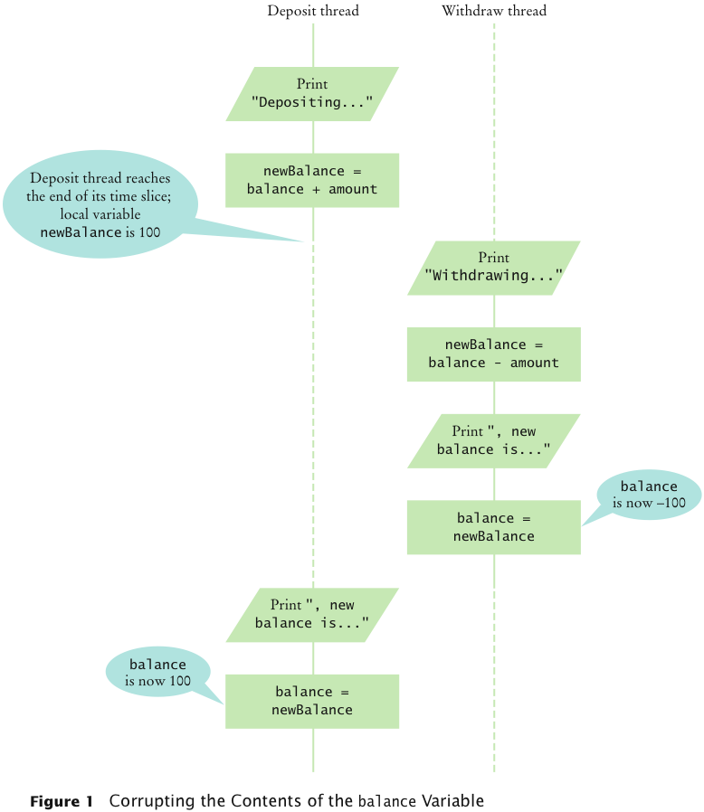
Race Condition | Balance Variable Corruption

Slide 31
Lock Object
Code that manipulates shared resource is surrounded by calls to lock and unlock: balanceChangeLock.lock(); Manipulate the shared resource
balanceChangeLock.unlock();
If code between calls to lock and unlock throws an exception, call to unlock never happens
When a thread calls lock, it owns the lock until it calls unlock
A thread that calls lock while another thread owns the lock is temporarily deactivated
Thread scheduler periodically reactivates thread so it can try to acquire the lock
Eventually, waiting thread can acquire the lock

Slide 32
Lock Object
Lock
Control threads that manipulate shared resources
Synchronize object access
Lock interface and several classes
ReentrantLock: most commonly used lock class
Object level lock
Controls whether a method can be run for a particular object. For the method to run it must acquire the lock for the object. Releases the lock when method ends
Class level lock
When a thread has a lock for a class, it is the only thread that can execute any of the calls of methods that require a lock
Notes:
https://docs.oracle.com/javase/tutorial/essential/concurrency/newlocks.html
https://www.geeksforgeeks.org/reentrant-lock-java/
https://www.geeksforgeeks.org/object-level-class-level-lock-java/

Slide 33
Activity | Lock Object
Typically, a lock object is added to a class whose methods access shared resources
public class BankAccount {
private Lock balanceChangeLock;
public BankAccount() { balanceChangeLock = new ReentrantLock(); ... } ... }
Implement Lock in BankAccount (class)

Slide 34
Question?
What happens if we omit the call unlock at the end of the deposit method?

Slide 35
Answer
What happens if we omit the call unlock at the end of the deposit method?
When a thread calls deposit, it continues to own the lock, and any other thread trying to deposit or withdraw money in the same bank account is blocked forever
Deadlock condition
Run DEADLOCK-example

Slide 36
Avoiding Deadlocks
A deadlock occurs if no thread can proceed because each thread is waiting for another to do some work first
How can we wait for the balance to grow?
We can’t simply call sleep inside withdraw method
In particular, no other thread can successfully execute deposit
Other threads will call deposit, but will be blocked until withdraw exits
But withdraw doesn’t exit until it has funds available

Slide 37
Condition Objects
To overcome problem, use a condition object
Condition objects allow a thread to temporarily release a lock, and to regain the lock at a later time
Each condition object belongs to a specific lock object
Run RESOLVED-DEADLOCK-example

Slide 38
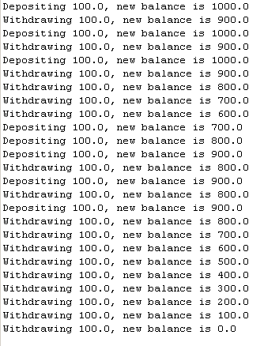
Example

Slide 39
Question?
What is the essential difference between calling sleep and await?

Slide 40
Answer
What is the essential difference between calling sleep and await?
Answer: A sleeping thread is reactivated when the sleep delay has passed. A waiting thread is only reactivated if another thread has called signalAll or signal.

